Slide 1
Types of communication between C & S
- Hrishikesh Kulkarni

Slide 2
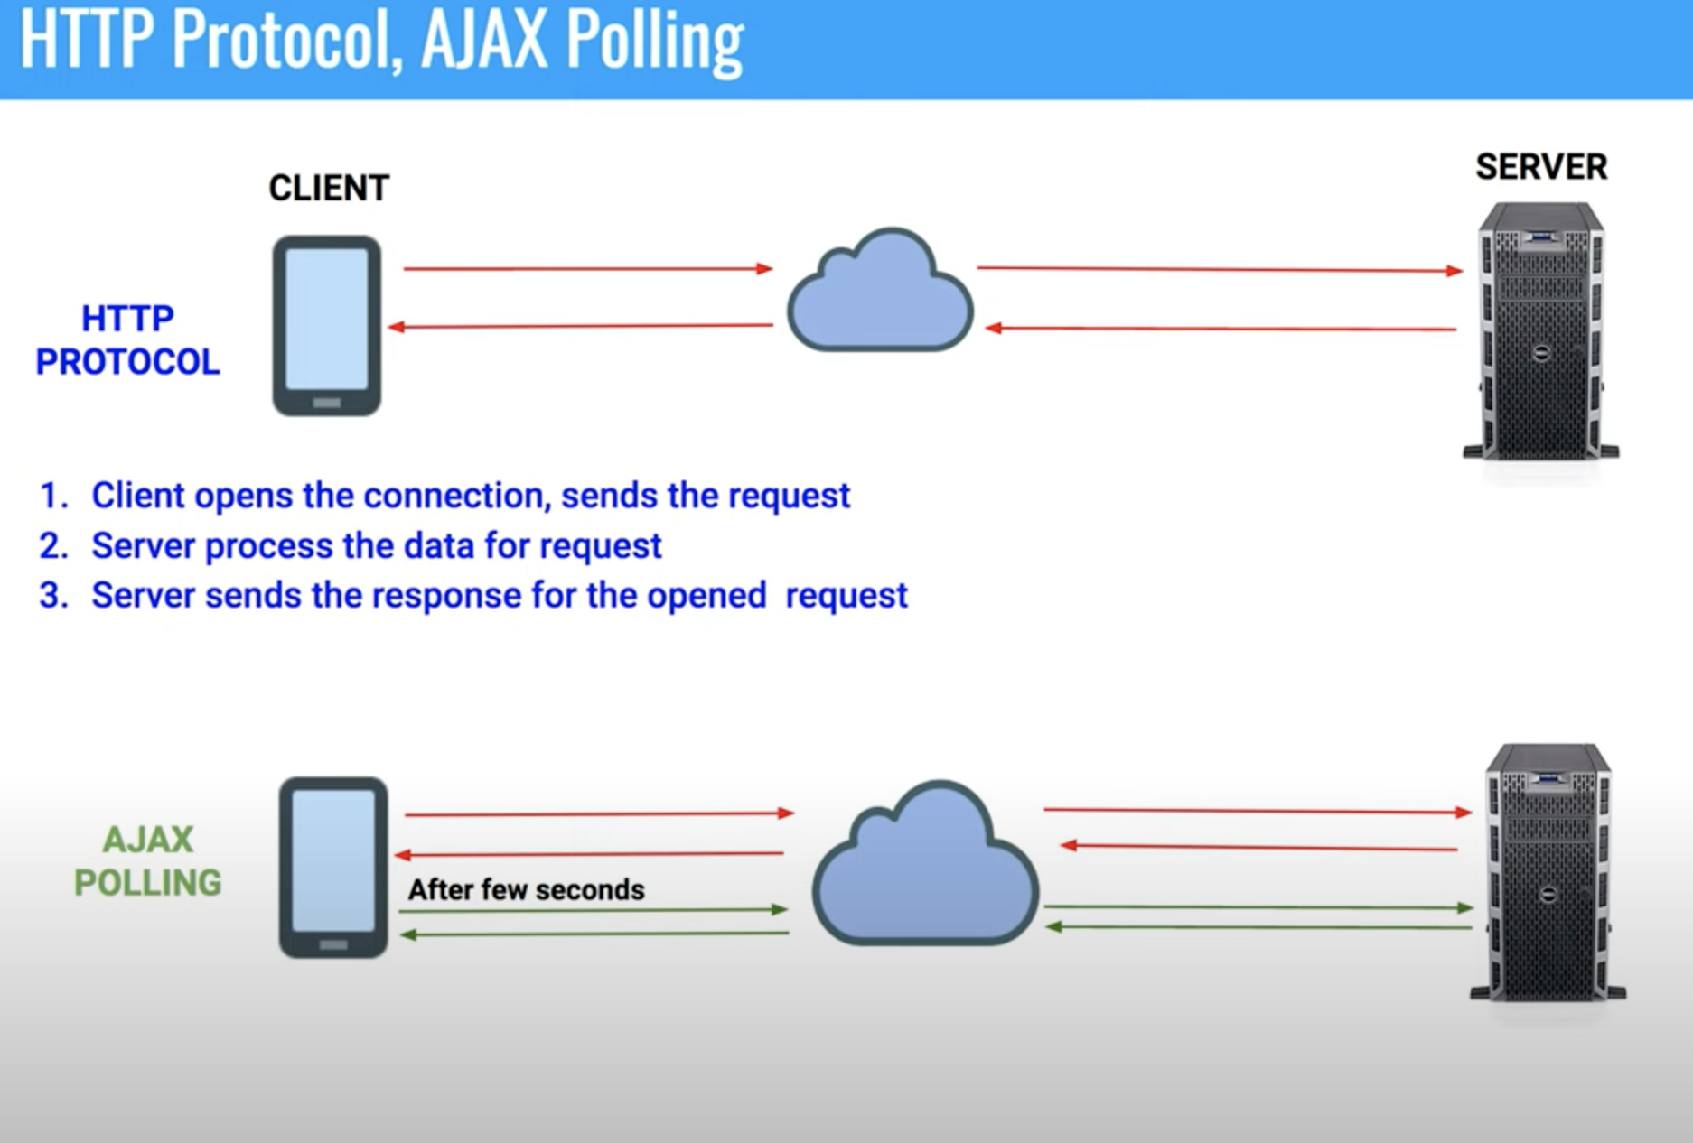

Slide 3
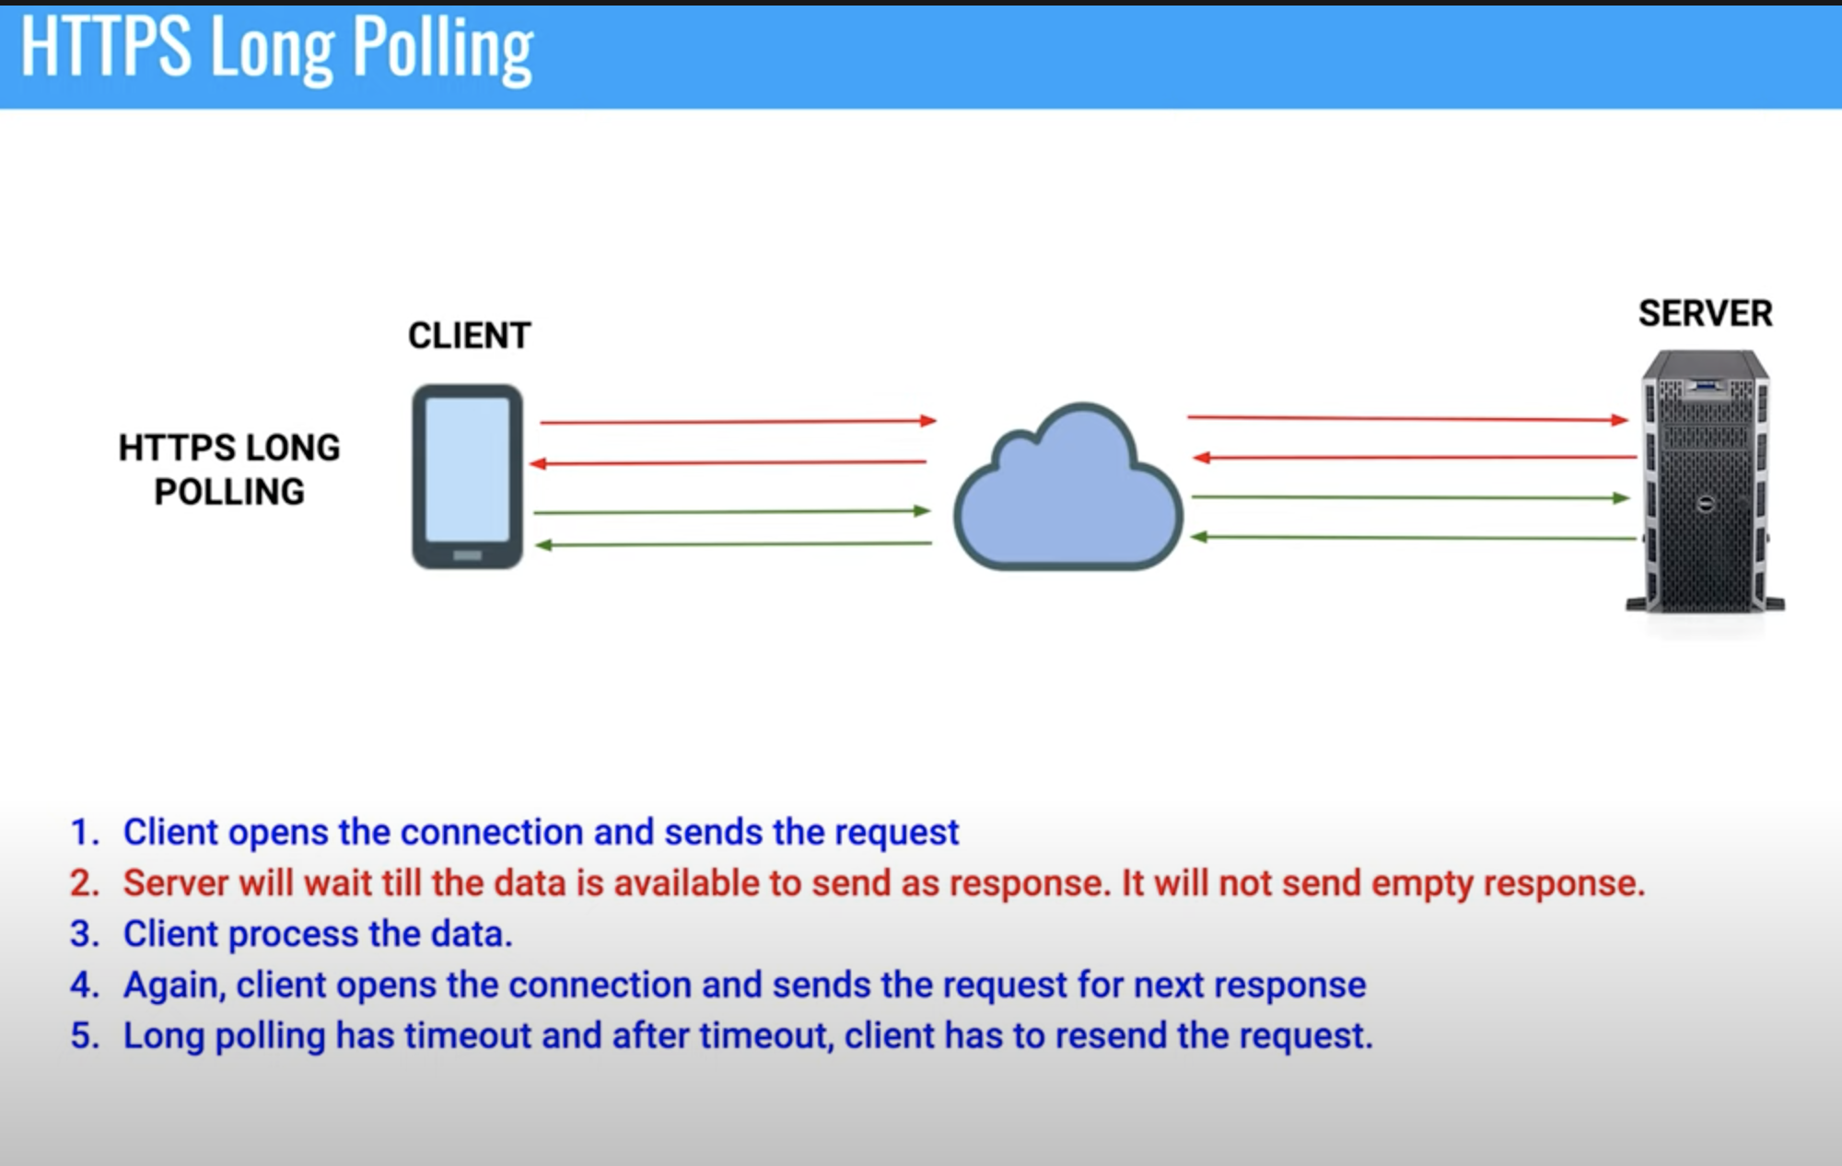

Slide 4
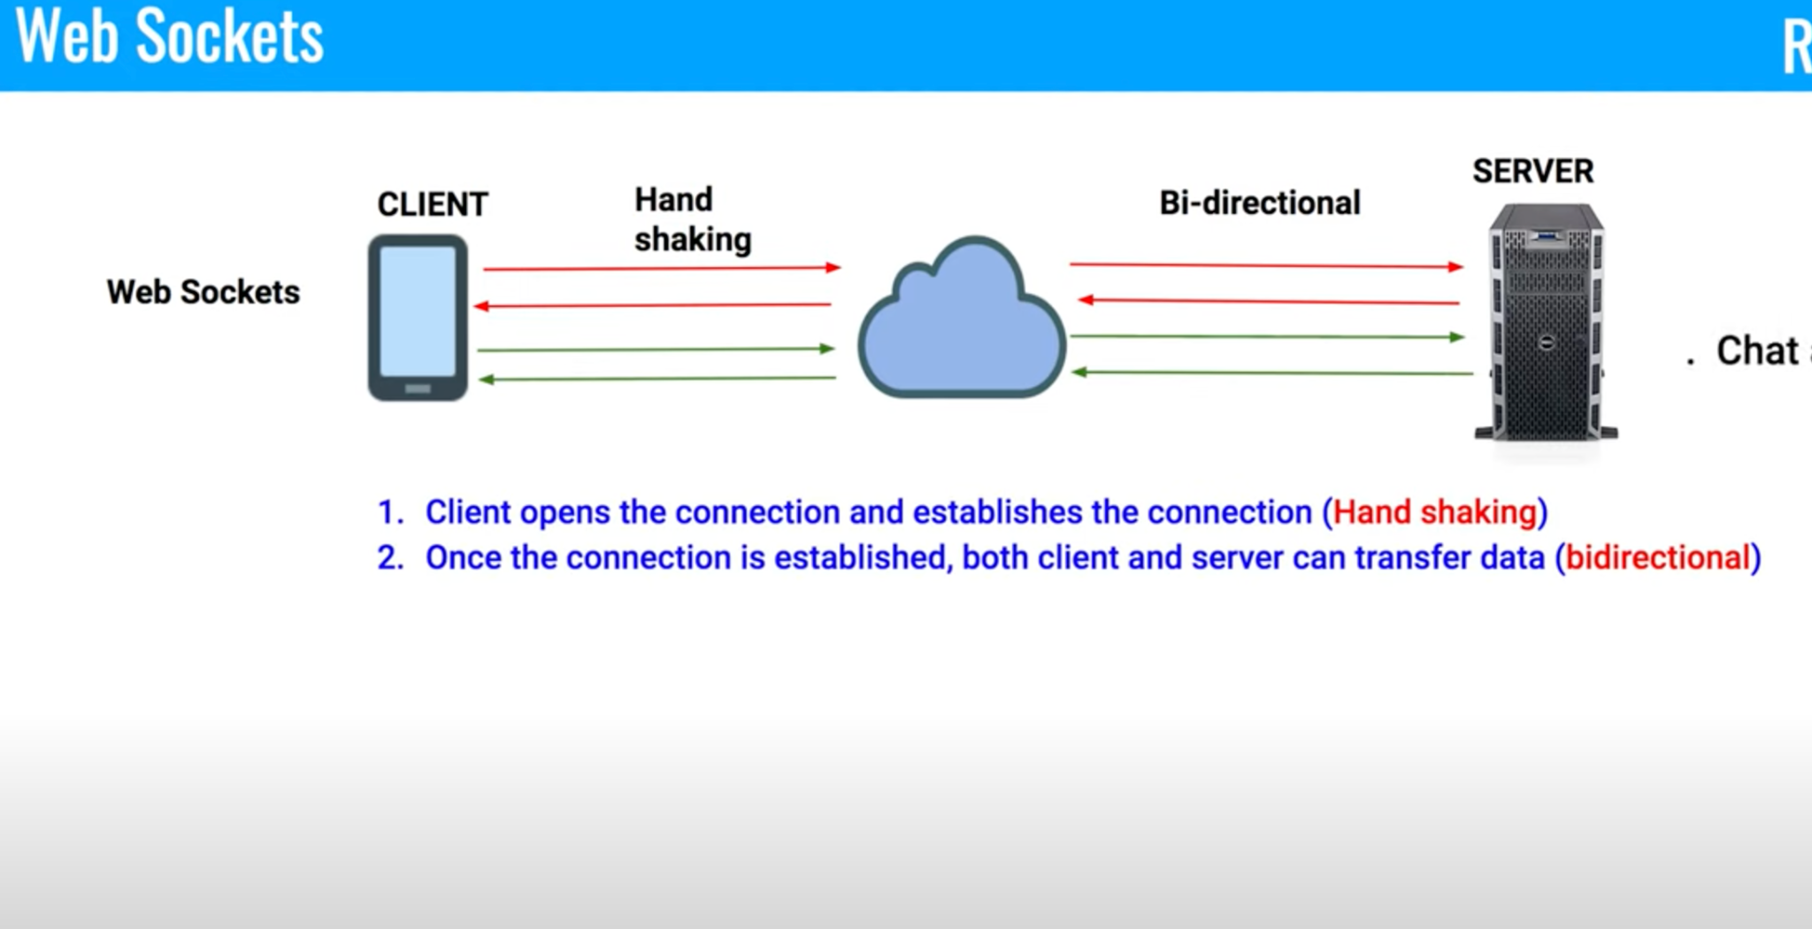

Slide 5
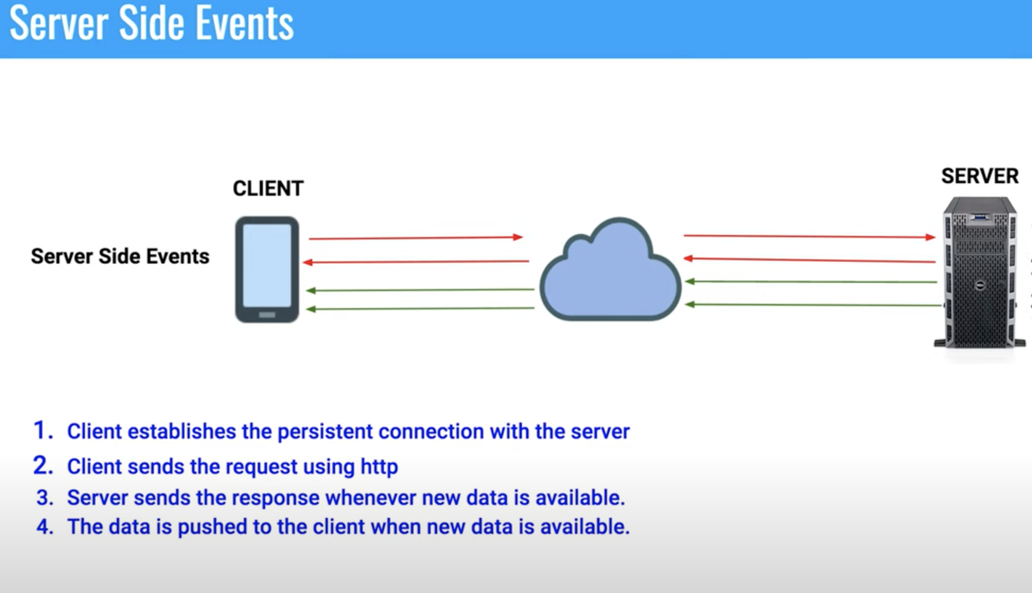

Slide 6
Pattern: Social media platform design
TWITTER

Slide 7
Requirements
Posting of tweet -> images, videos, text
Resharing tweet
Reaction, Commenting on tweet
Reaction on comment
Timeline -> Followers tweets. Sorting by published date, reaction score
User profile management service
Trending hashtags
Comment on comment for 1 level
Weekly analytics
Following user
Specific user timeline
Analytics for filtering/flagging
Max 140 chars, max 10MB
Searching for user/post
Monitoring & notification

Slide 8
NF Requirements and estimations
100M daily active users
1:100 write:read ratio
500M daily read req
5M daily write req
_________ read req/s
Eventually consistent -> AP system
World-wide userbase
Minimum latency for feed getting
Network failures are implicitly handled
Maximal throughput of system
Fast streaming
Durable systems
Archival after older data

Slide 9
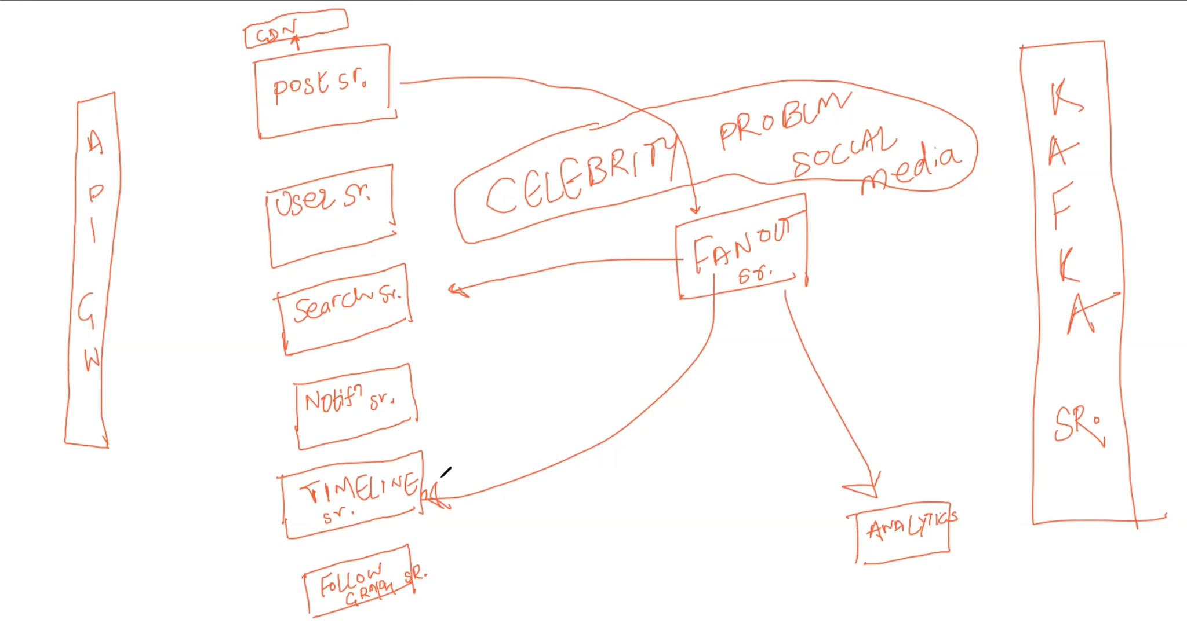

Slide 10
API Design

Slide 11
Schema Design

Slide 12
High Level Design

Slide 13
Identifying bottlenecks, Single PoF

